Slide 1

Loan Portfolio Risk using Machine Learning
By Marcos Dominguez

Slide 2
Can I predict the total loan loss of a bank’s loan portfolio? (create diagram slide)
Objective:
Predict which loans in a portfolio are “risky”
Classification problem
Focus on recall to capture all risky loans
Predict loan loss amount (in % of loan) using linear regression
e.g.: 15% loan loss means 85% was paid back
Linear regression problem
Establish audience (in progress)

Slide 3
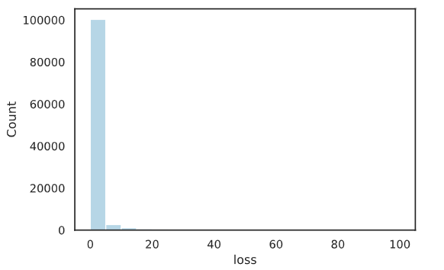
Data (include dist of losses)
Portfolio of ~100,000 loans
Features: 771 numerical, anonymized columns
Target: loan loss, from 0 to 100%
Distribution of loan loss
Highly imbalanced

Slide 4
Methodology (visualize)
EDA
Data cleaning, NaN values, dtypes
Model Selection:
Over/Undersampling
Hyperparameter tuning
Feature Selection/Engineering
Prediction Pipeline:
Separate good loans from “risky” loans
Predict loan loss percentage of “risky” loans

Slide 5
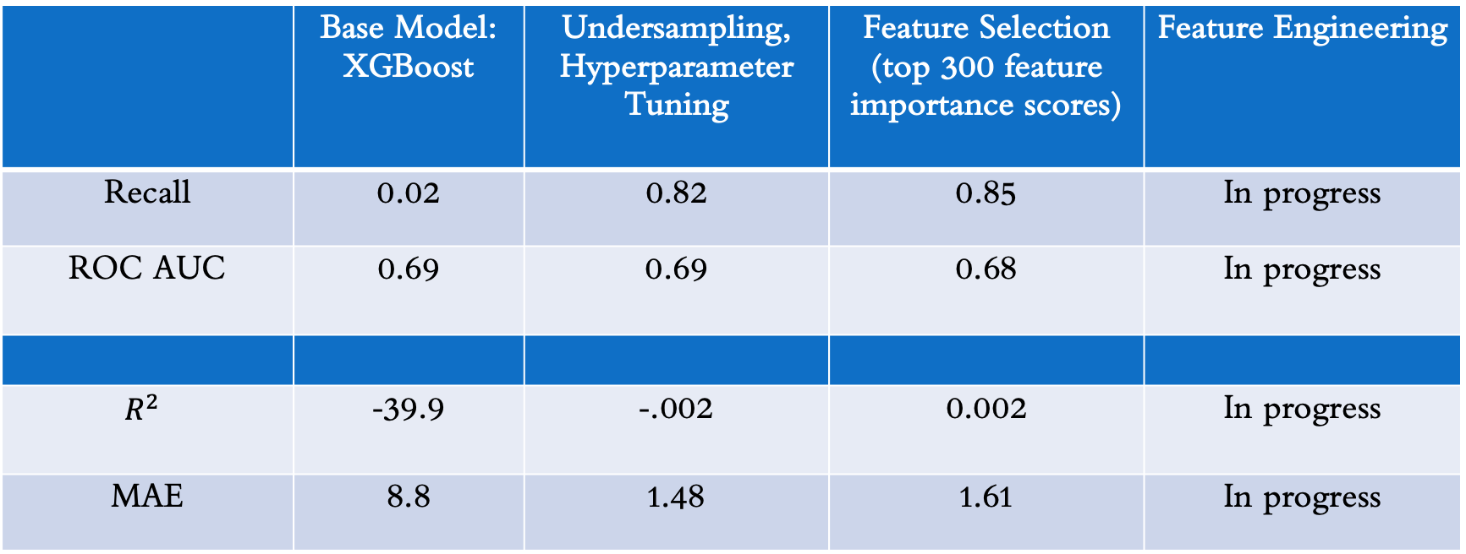
Results (visualize better)
 | Base Model: XGBoost | Undersampling, Hyperparameter Tuning | Feature Selection (top 300 feature importance scores) | Feature Engineering
Recall | 0.02 | 0.82 | 0.85 | In progress
ROC AUC | 0.69 | 0.69 | 0.68 | In progress
$$R^{2}$$ | -39.9 | -.002 | 0.002 | In progress
MAE | 8.8 | 1.48 | 1.61 | In progress

Slide 6
Results
Predicted # of risky loans: 13,067
ADD % of portfolio
Predicted average portfolio loan loss: 1%
Compare to actual portfolio loan loss
Seems low…

Slide 7
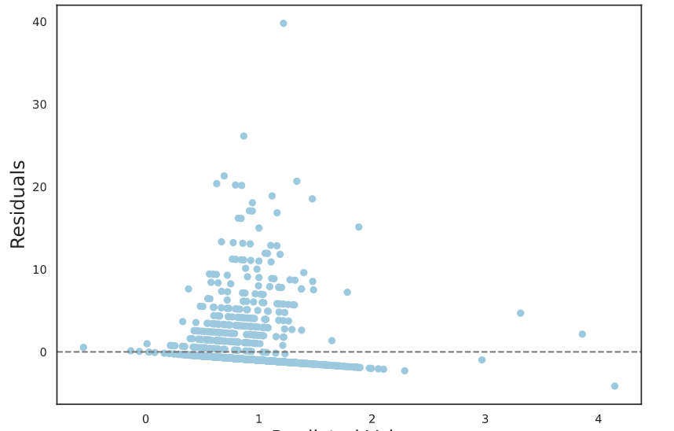
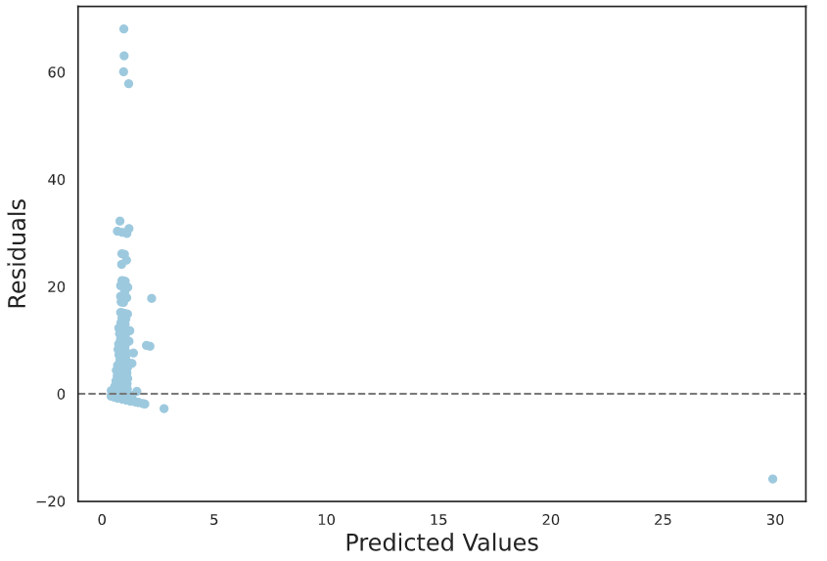
Results (residual plots) REMOVE SLIDE
Base Model
Optimal Model (so far ☺)

Slide 8
Banks are the end-user (move to beginning)
A list of potential risky loans and loan loss amount
Extremely useful for banks:
Loans are the largest portion of any bank’s business
Preventive measures
Capital reserves requirements
Increase profits
Decrease risks

Slide 9
Next Steps
Improve models via feature engineering
Linear model’s R-squared is concerning
Create streamlit app containing process and results
If time permits…

Slide 10






Thanks!
Open source tools:
Questions?
Contact me at md.ghsd@gmail.com

